Slide 1
CS2040 Lab11 B03 (Please set up your camera for Visualgo quiz) 09/11/2020

Slide 2
Trip
Lab9 Problem 1

Slide 3
Question
Check whether there exists a path from S (source) to T (destination) where the interest values are strictly increasing.

Slide 4
Idea
Because we only want paths that consist of edges of increasing values, we may only keep single-directional edges that point from lower-value cities to higher-value ones.
For example, if an edge exists between x(5) and y(8), we only record x-y, while discarding y-x.
In this way, we can traverse the graph without worrying about taking invalid edges.
Graph traversal: BFS? DFS?

Slide 5
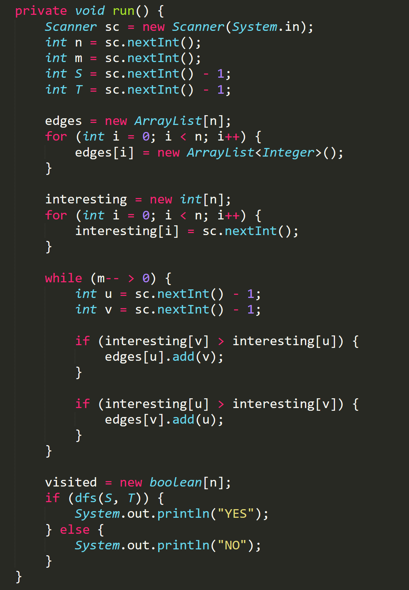
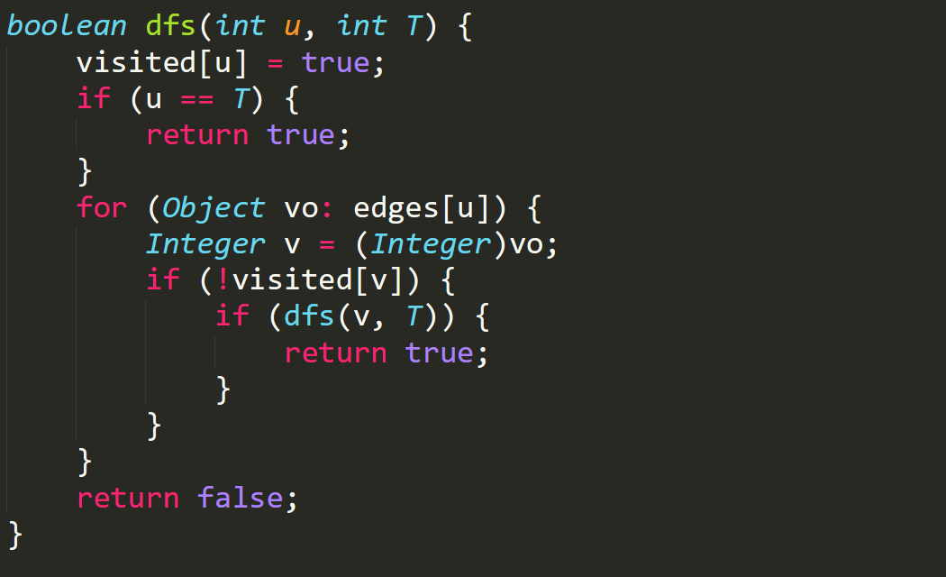

Slide 6
Covid
Problem 2

Slide 7
Summary
Given n people, m pairs of people will meet every weekend.
There exists the disease Covid-19. Every time a person is caught with this disease, he/she will only start to transmit it in the following week to whoever he/she meets.
At week 0, k people caught Covid-19. The weekly meetings will start from week 1.
Find the earliest time where everyone caught Covid-19 or print out “Some are safe” if there are some people that will never be infected.

Slide 8
Approach
BFS from the initial k infected people
Ignore the visited (infected) nodes.
Keep track of which week a node is first visited (infected).
Finally, find out if there are any nodes which are not visited or return the max number of weeks required to visit a node.

Slide 9
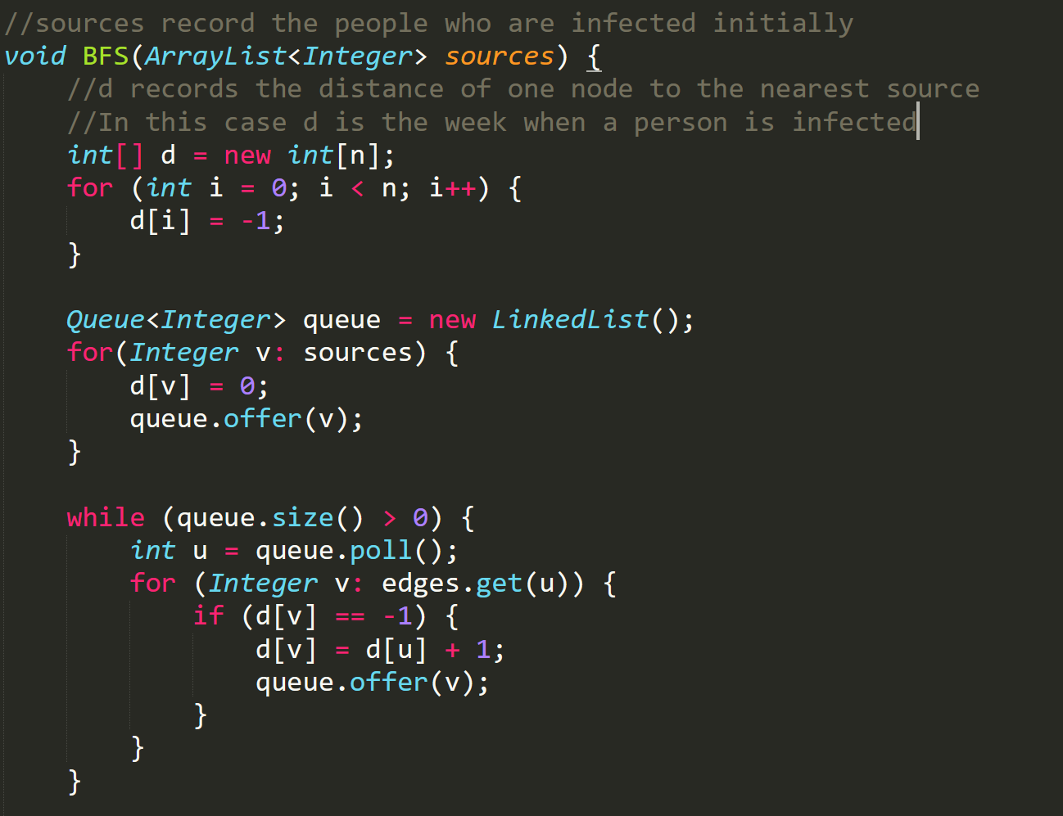

Slide 10
Visualgo quiz

Slide 11
Visualgo quiz
15 questions in 15 minutes
The meeting will be recorded during quiz.
Make sure you record the whole screen including the timestamp
Upload your recording to TG group immediately after the quiz (don’t edit your message if you upload a wrong video, just send another message to upload),
and name your video as NAME+MATRIC NUMBER+ SCORE
https://visualgo.net/training?diff=Hard&n=15&tl=15&module=hashtable+bst+avl+heap+graphds+dfsbfs+sssp+mst

Slide 12
Hypercar
Lab10 Problem 1

Slide 13
Summary
Given a graph of n vertices with m bidirectional weighted edges, find max W such that:
In the subgraph that only contain edge with weight >= W,
S and T are connected.

Slide 14
Example
Input | Output
6 7 1 6 1 2 6 2 3 5 3 6 1 1 3 2 2 4 2 1 4 3 4 6 4 | 3

Slide 15
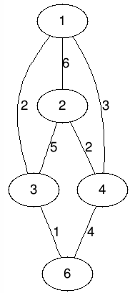
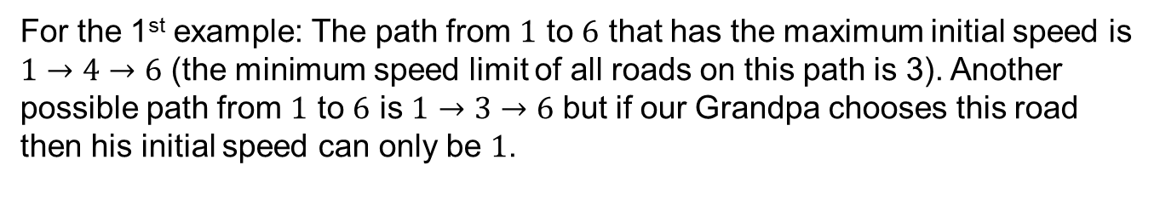

Slide 16
Insight
If S and T are not connected, then “Impossible”, else answer always exist.
Call the set of edges that have weight >= W1 be E(W1)
If W1 <= W2, E(W2) is a subset of E(W1)
-> If E(W2) make S, T connected then E(W1) will also make S, T connected.

Slide 17
Solution 1
Modifying Kruskal’s algo and using UFDS
Add edges to UFDS in decreasing order by weight, stop once S and T is connected.
Time complexity: O(m log m)

Slide 18
Solution 2
Binary search answer on [0, maxW], use any type of graph traversal to check if S and T are connected or not for any E(x).
(maxW = max(w[i]), i : 1 -> m)
Time complexity: O((n + m) log(maxW))

Slide 19
Pizza Steve
Lab10 Problem 2

Slide 20
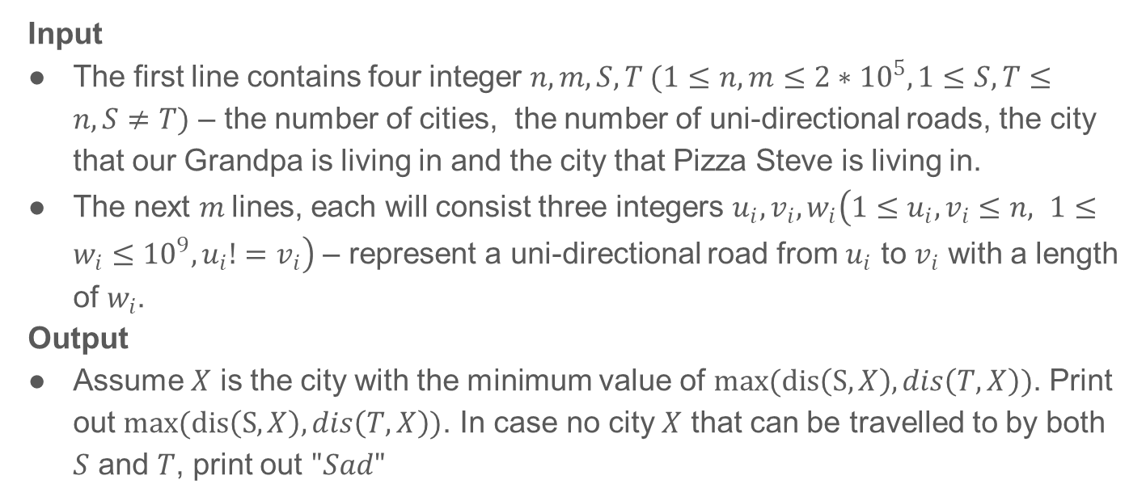
Problem Statement
Input
The first line contains four integer $n, m, S, T (1≤n, m≤2∗{10}^{5}, 1≤S,T≤n, S≠T)$ – the number of cities, the number of uni-directional roads, the city that our Grandpa is living in and the city that Pizza Steve is living in.
The next $m$lines, each will consist three integers $u_{i}, v_{i},w_{i}\left(1≤u_{i}, v_{i}≤n, 1≤w_{i}≤{10}^{9}, u_{i}!=v_{i}\right)$ – represent a uni-directional road from $u_{i}$ to $v_{i}$ with a length of $w_{i}$.
Output
Assume $X$ is the city with the minimum value of $max(dis\left(S,X\right),dis\left(T,X\right))$. Print out $max(dis\left(S,X\right),dis\left(T,X\right))$. In case no city $X$ that can be travelled to by both $S$ and $T$, print out $"Sad"$

Slide 21
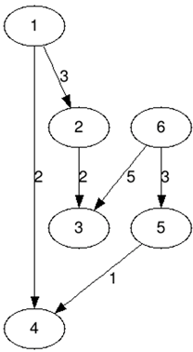
Input Output
Input (pizzasteve1.in) | Output (pizzasteve1.out)
6 6 1 6 1 2 3 2 3 2 1 4 2 6 5 3 5 4 1 6 3 5 | 4

Slide 22
Things to Consider...
Output max (dist(S,X) , dist(T,X))
3 Things required:
Point X
Shortest distance from S - X
Shortest distance from T - X
Which SSSP Algo? BFS? Bellman-Ford? Dijkstra? Topological Sort?

Slide 23
Understand when to use which Algo
Condition | Algo | Time Complexity
Unweighted/Equal Weight | BFS | O(VE)
Directed Acyclic Graph | Topological Sort | O(V+E)
No -ve Weight Cycles | Bellman-Ford | O(VE)
No -ve Weights | Dijkstra’s | O((V+E)logV) Faster than Bellman-Ford

Slide 24
After running Dijkstra’s
0
From 1
From 6
INF
3
INF
INF
0
INF
3
5
5
2
4

Slide 25
Countways
Lab10 Problem 3

Slide 26
Understand Requirements
Design

Slide 27
Understand Requirements
Shortest distance from S to T
Number of different paths from S to T that have that shortest distance
Connected? Guaranteed to reach T?
Weighted/unweighted? Sign of weights?
Directed/undirected?

Slide 28
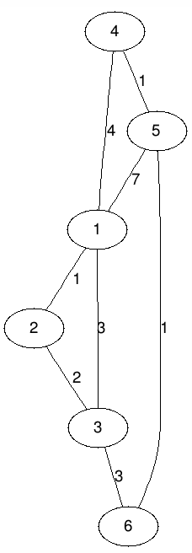


Understand Requirements

Slide 29
Design
Find shortest path from S to T
Constant +ve weight?
All weights positive?
All weights non-negative?
No restriction on sign of weights?
Negative weights can form negative cycle?

Slide 30
Design
Find shortest path distance
4
5
0
1
3
6

Slide 31
Design
Find number of
diff shortest paths
How to identify which edge(s) to take?
4
5
0
dStart = 0
1
dFrom
dTo
3
weight
6
weight

Slide 32
Design
Find number of
diff shortest paths
4
5
0
1
3
6

Slide 33
Design
Find number of
diff shortest paths
Current vert must have correct numWays before moving on
4
1
5
1
0
1
1
1
3
2
3
6

Slide 34
Design
Find number of
diff shortest paths
4
5
0
1
1
3
6

Slide 35
Design
Find number of
diff shortest paths
Should we now update node 3’s neighbours?
4
1
5
0
1
1
1
1
3
6

Slide 36
Design
Find number of
diff shortest paths
4
1
5
1
0
1
1
1
2
3
6

Slide 37
Design
Find number of
diff shortest paths
What order is this?
4
1
5
1
0
1
1
1
2
3
3
6

Slide 38
Design
Find number of
diff shortest paths
Really?
4
1
5
1
0
1
1
1
2
3
3
6

Slide 39
Solution
Dijkstra’s algo
Init distances to inf but source to 0
Build PQ / TreeSet of nearest unvisited verts
Visit lowest-distanced vert
For each neighbour, relax dist to neighbour
Repeat step 3 till no verts left (or no reachable verts left)

Slide 40
Solution
Dijkstra’s algo
3. Visit lowest-distanced vert
When there is no –ve edge, lowest-distanced vert will NEVER be updated again.
Why?

Slide 41
Solution
Prevent repeated visits of a vertex and its neighbours
Can follow the order Dijkstra’s algo takes
4
5
0
1
3
6

Slide 42
Good news
There will be deadline extension for lab10!

Slide 43
Hope you’ve Had Fun!
Queue
Tree
Dijkstra
Heap
UFDS
HashMap
Kruskal
Bellman-ford
Stack
Prim
BFS
DFS
……

